Slide 1


Child Well-Being Capstone Project
Business
Intelligence
Claudia Ayonote
Katie Breshers
Adelaide Obasanya
Robert Rodden

Slide 2
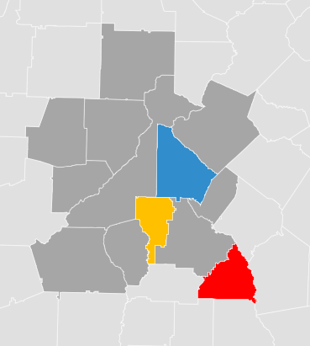
3 Part Plan
Early Childhood Education Programs and Affordable Childcare
Education Support via STEM programs in Middle and High School and Volunteer/Mentorship opportunities in High School
Advocacy for educational policies and child development programs
Business Intelligence
Child Well-Being Capstone
Notes:
NOTE: To change images on this slide, select a picture and delete it. Then click the Insert Picture icon in the placeholder to insert your own image.

Slide 3
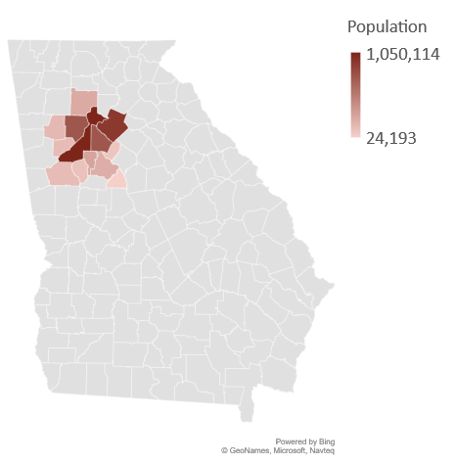
Overall CWB
Children
Family
Community
HS College & Career Readiness Score
HS Graduation Rate
% Exceeding 3rd Grade Reading
% Exceeding 8th Grade Math
% Low Birth Weights Births
% Under 18 w/o Health Insurance
% Under 18 in Poverty
% Family Not Financially Stable
% Cost Burdened Household
% Moms with no HS Diploma
% Enrolled in Post-secondary Education
% Adults with no HS Diploma
% Adults w/o Health Insurance
Unemployment Rate
County | Tracts
Butts | 3
Cherokee | 26
Clayton | 49
Cobb | 120
Coweta | 20
DeKalb | 144
Douglas | 20
Fayette | 20
Fulton | 202
Gwinnett | 113
Henry | 25
Paulding | 19
Rockdale | 15
Total | 776
5,000-10,000
people per tract
Business Intelligence
Child Well-Being Capstone

Slide 4
Average of All Counties is 0.59
Business Intelligence
Child Well-Being Capstone
Notes:
NOTE: To change images on this slide, select a picture and delete it. Then click the Insert Picture icon in the placeholder to insert your own image.

Slide 5
R² = 0.9397
Extra data source: https://opb.georgia.gov/social-and-economic-data
Business Intelligence
Child Well-Being Capstone
Notes:
NOTE: To change images on this slide, select a picture and delete it. Then click the Insert Picture icon in the placeholder to insert your own image.

Slide 6
R² = 0.6386
R² = 0.7147
Business Intelligence
Child Well-Being Capstone

Slide 7
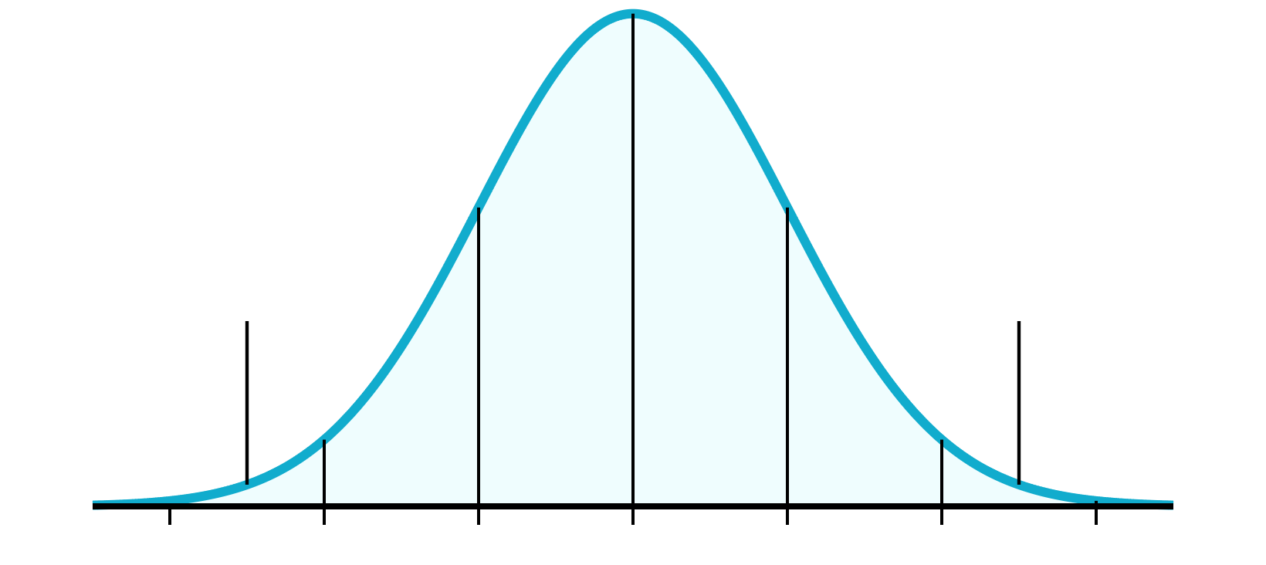

Slide 8
3-Part Plan
Pre-K - 5th grade
Institute after-school reading programs and affordable child care
For Middle and High School levels:
Invest in STEM schools and programs
Provide Volunteer and Mentorship programs for High Schoolers
Policy and Advocacy
Lottery funded Pre-K slots, reducing class size and investing in a quality workforce
STEAM and Child Care Development Block Grant
Removing barriers to completing a post-secondary education

Slide 9



United In Strength

Slide 10
What Are Your Questions?
Claudia Ayonote
Katie Breshers
Adelaide Obasanya
Robert Rodden
Business Intelligence
Child Well-Being Capstone

